Slide 1

K. K. Wagh Polytechnic, Nashik. Hirabai Haridas Vidyanagari, Amrutdham, Panchavati, Nashik-422003 Department of Computer Technology
Industrial Training Summer 2023
Name of Industry: R3 System India Pvt. Ltd.
Duration: 6 weeks
Presentation By:
Name of Students: Aditya Arun Dhakane
Shraddha P. Gaidhani
Class: TYCM-Lin

Slide 2


Department of Computer Technology Industrial Training Summer 2023
Introduction of Industry
Name of the Company :- R3 SYSTEMS INDIA PVT.LTD
Location : - First Floor, Rohini Apartment, KBTCircle, GangapurRoad, NearSaraswatBank, ThatteNagar, Nashik,Maharashtra- 422005,India
Establishment : - 2017
Email & Web Address :- india.r3sys@gmail.com https://www.r3sys.com/
Name and Designation of Contact Person:- Mr. Gauresh Suryawanshi (Chief Technical Officer)
Contact No:- 8600033181
Type of Product:- IT Software Development & Consultancies
Type of Control :- Private
Type of Company :- Small Scale
Total Number of Employees in Company :- 30
Total Turnover of Company :- 20 Lakh

Slide 3





Department of Computer Technology Industrial Training Summer 2023
Services Provided…
Website Design Development
Mobile application development
Project Consulting
Corporate Training
Digital Marketing

Slide 4

Department of Computer Technology Industrial Training Summer 2023
Industrial Trainer/Supervisor Details
Name:- Mr. Gauresh Suryawanshi Sir
Designation:- CEO(Chief Executive Officer)
& Software Developer
Experience:- 4-5+ yrs. Experience
Specialization:- Web Developer & Project Consultant
Email- gauresh.r3sys@gmail.com

Slide 5
Department of Computer Technology Industrial Training Summer 2023
Course Outline during Training
Objectives of Training: To develop specific and useful knowledge, skills and techniques.
Work performed week wise:
Weeks | Topics/ Work | Description
W1 | Software & their types. Features of Java. Identifiers. Data types & its Types. Constants. Method with different Approaches. Object Oriented Principles. Types of Members & Methods. Data Printing and Program Structure. Constructor & their Types. Wrapper Classes. This Keyword. Reading data from user. Inheritance & their types. Super Keyword. Polymorphism & their types. Method Overloading & Overriding, Data Abstraction, Data Encapsulation. Dynamic Binding. Abstract Method & Classes its types with Limitations. Etc., | Solved Assignment `s and perform various programs on the mentioned topics.

Slide 6
Department of Computer Technology Industrial Training Summer 2023
Course Outline during Training
Weeks | Topics/ Work | Description
W2 | Interface - Advantages, Syntax & Example. Packages – Purpose, Defination, Advantages. Types of Packages. List of packages. Access Modifiers. Exception handling with blocks, Errors & Exception. Multithreading. Life cycle of thread. Runnable Interface. Object Type Casting. Etc., Collecion Framework- Purpose, Defination, Advantages. Types of CF. Its Classes & Interfaces. Collection- List, Set, Map, Iterator | Solved Assignment `s and perform various programs on the mentioned topics.
W3 | JDBC Its Architecture. Steps for DataBase Connection. Loading the drivers. Interaction with DB. Servlet – Introduction, How to Create ,Development of Servlet, Life Cyc le . JSP –Intro -duction, How to Create, Life Cycle, JSP tags,Implicit Objects in JSP. | Solved Assignment `s and perform various programs on the DB Connectivity. Making Servlet & JSP pages

Slide 7
Department of Computer Technology Industrial Training Summer 2023
Course Outline during Training
Weeks | Project Work | Description
W4 | Project Topic Research Requirements Design and Architecture | Search & Finalize Project Topic : EV Charging Station Finder. Gather data and requirements on existing EV charging stations and map their locations. Create a user-friendly interface for the website.
W5 | Development & Implementation Data Integration | Execute the project plan and build the solution. Build the website module by module with features like search, updation pw, deletion and CS Approval. Develop a system to regularly update and maintain the charging station database.

Slide 8
Department of Computer Technology Industrial Training Summer 2023
Course Outline during Training
Weeks | Project Work | Description
W6 | Testing and Quality Assurance Monitoring and Evaluation Project Closure | Verify that the project meets the required standards and functionality. Also Findout any bugs,defect occurred in project and fix it properly. Continuously assess the project's performance and gather feedback from project guide. Officially close the project, evaluate its success, and learn from the experience.

Slide 9





Department of Computer Technology Industrial Training Summer 2023
Course Outline during Training
Languages/Platform/tools used: English, Java, HTML, CSS, Java Script, Eclipse IDE, MySQL, JDK 1.8,Xampp,Chrome etc.,
Assignments solved:
Banking Services Console based Application
Remainder Services Console based Application
Student Record Services Console based Application
Console based Programs on basic concepts of Java

Slide 10
Department of Computer Technology Industrial Training Summer 2023
Course Outline during Training
Projects developed:
EV Charging Station Finder Website
Blood Bank Management System Website
Bank Management Services Website
Registration Form
New learning skills acquired: Working on projects, solving the technical issues, confidence buliding.
Technologies learned:
Web Designing
Web Development

Slide 11
Department of Computer Technology Industrial Training Summer 2023
Project Details implemented during Training
Title: EV Charging Station Finder
Development Platform: Eclipse IDE, JDK 1.8, MySQL server
Output Generated: Developed Website
Snapshots :

Slide 12
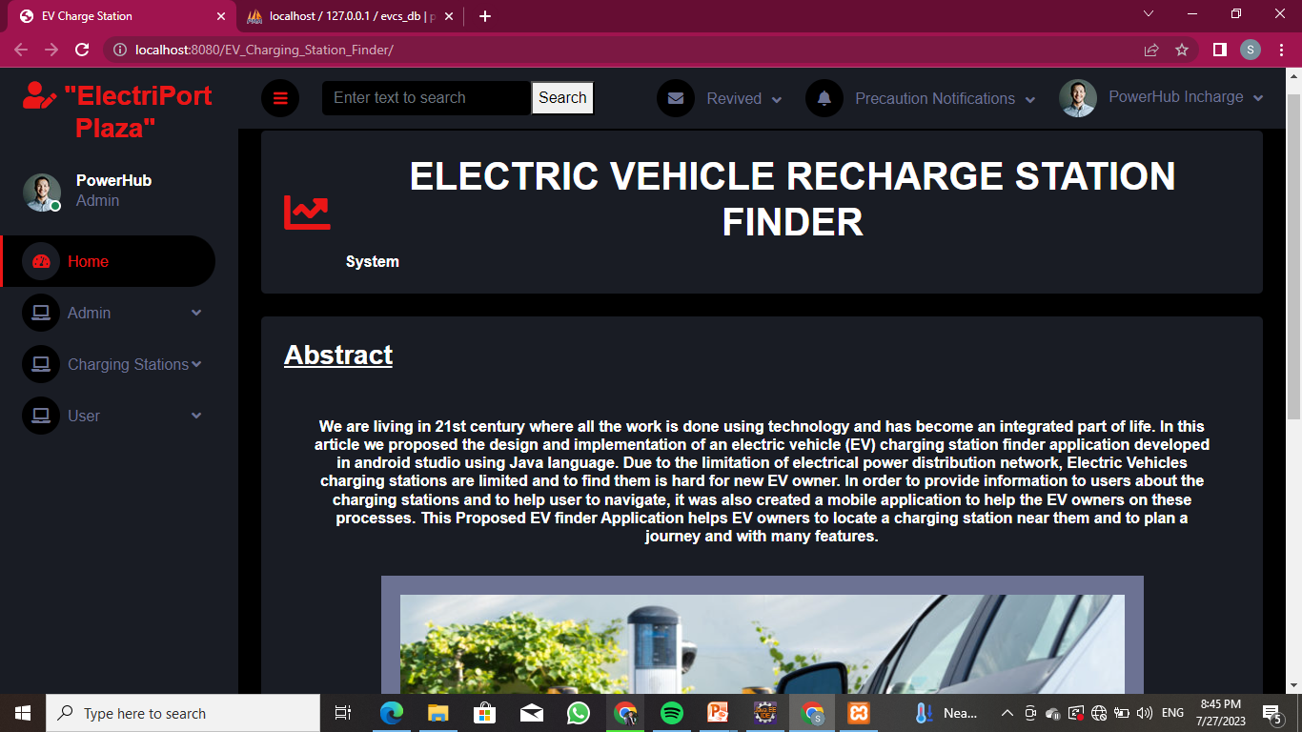
Home Page

Slide 13
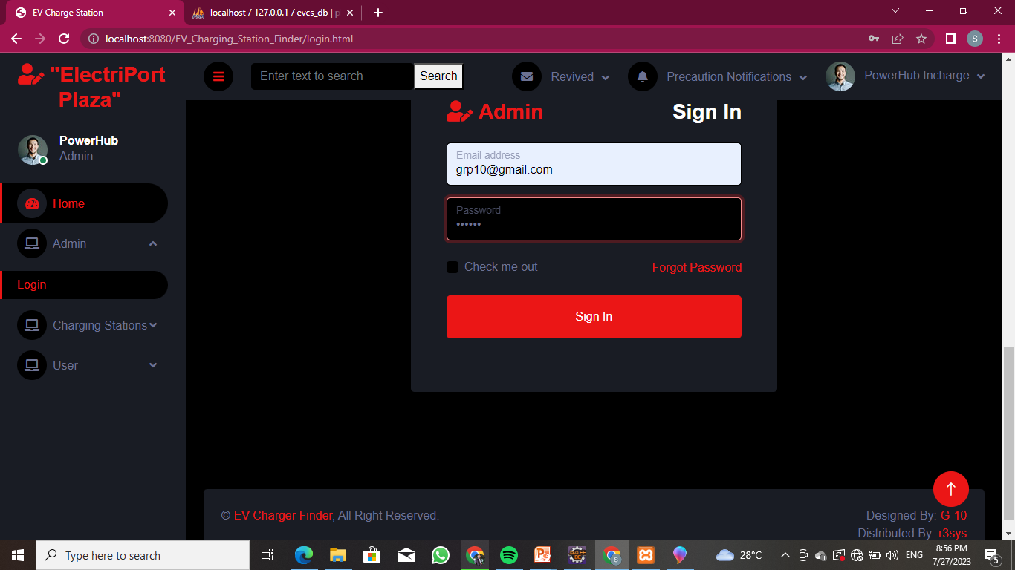
Admin Module

Slide 14
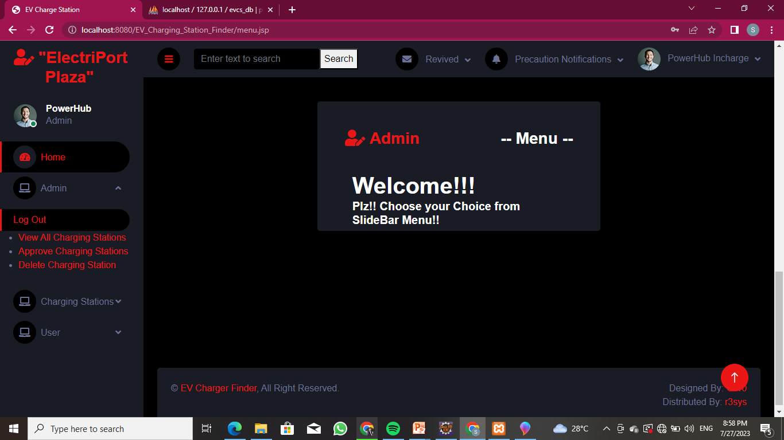
After Admin Login Shows Admin Menu

Slide 15
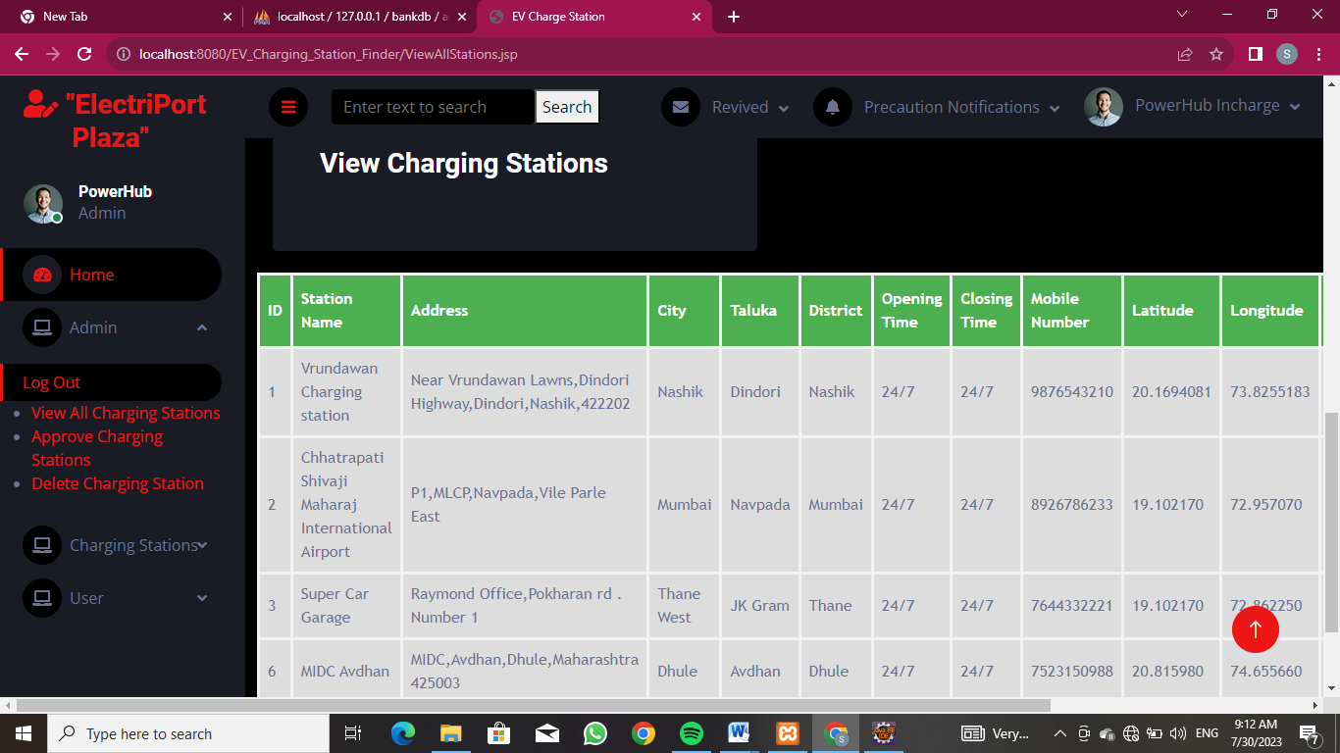
Admin Module SubMenu View All Charging Station

Slide 16
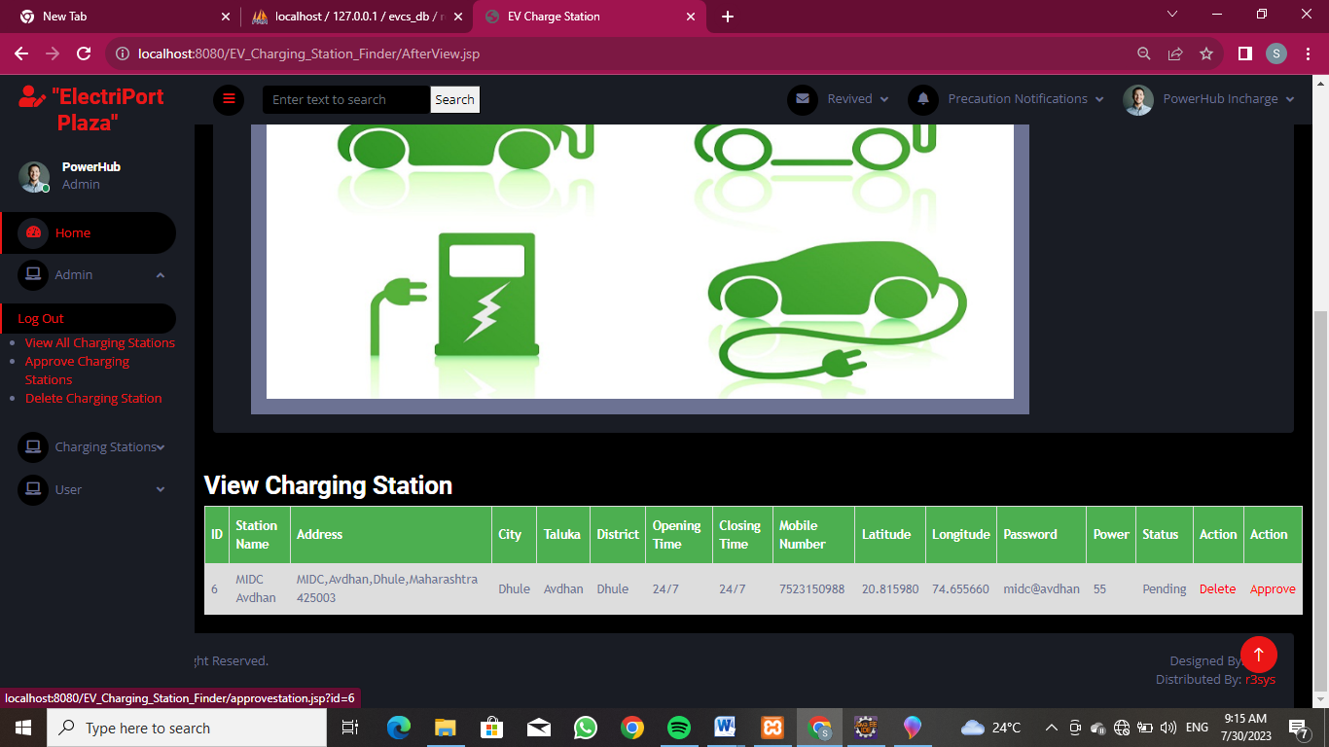
Admin Module SubMenu Approve Charging Station

Slide 17
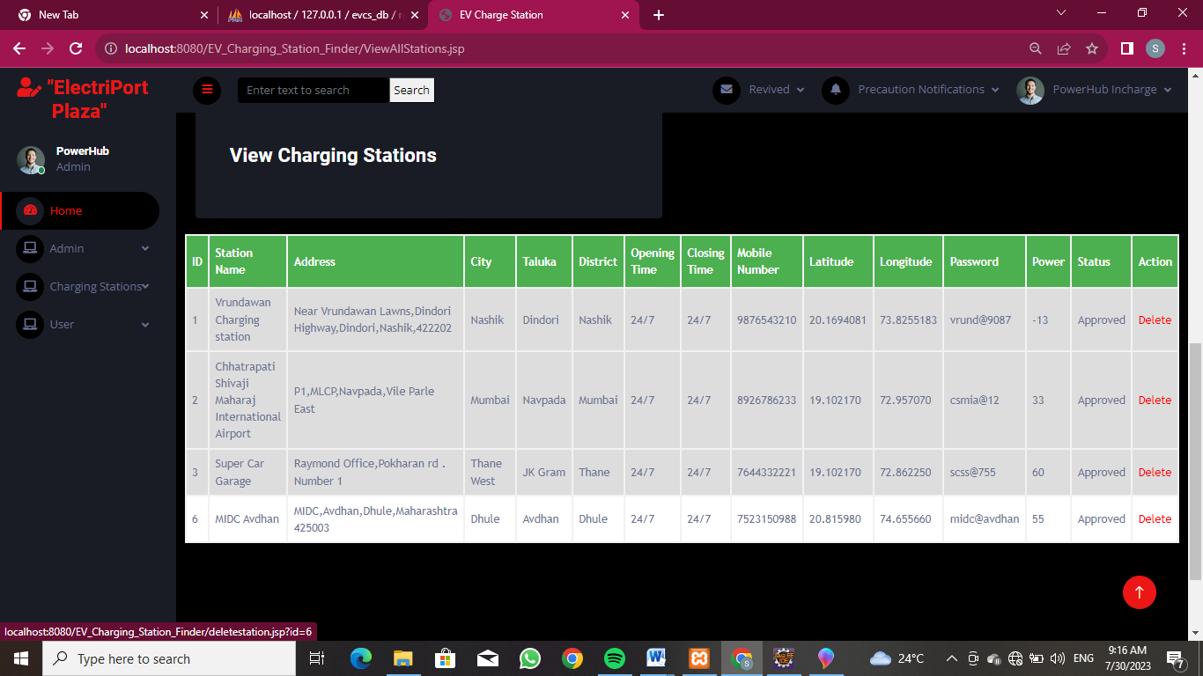
Admin Module SubMenu Delete Charging Station

Slide 18
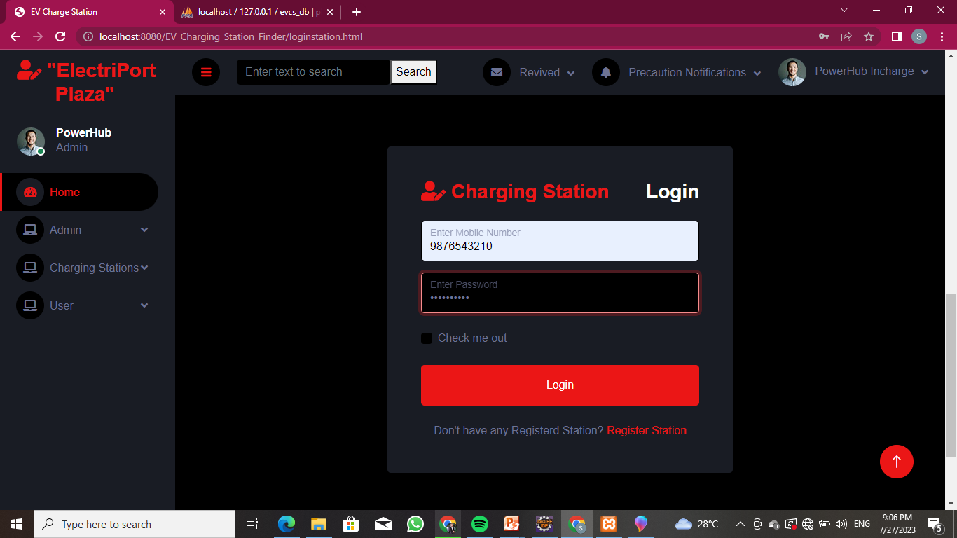
Charging Station Module

Slide 19
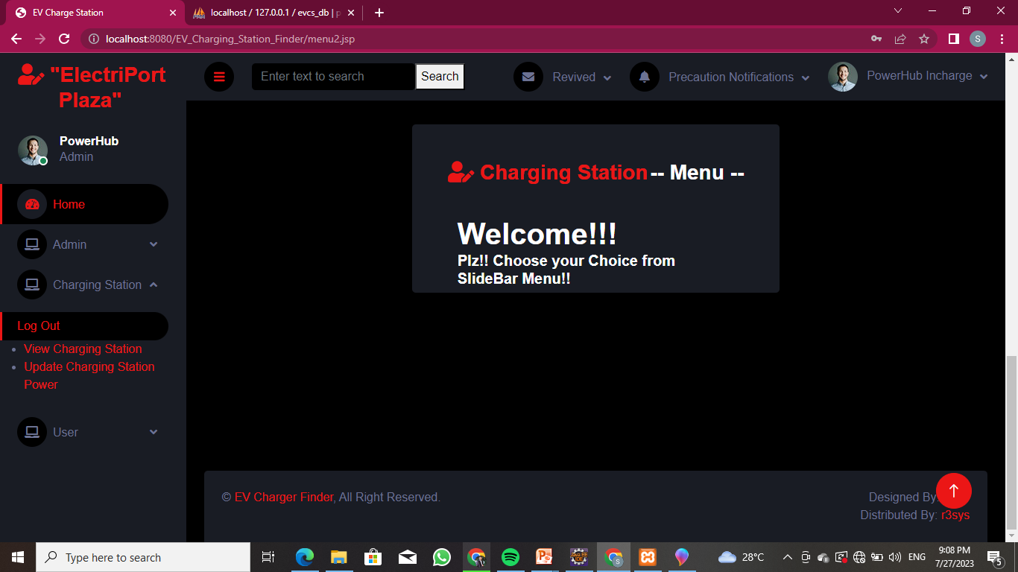
After Charging Station Login Shows Charging Station Menu

Slide 20
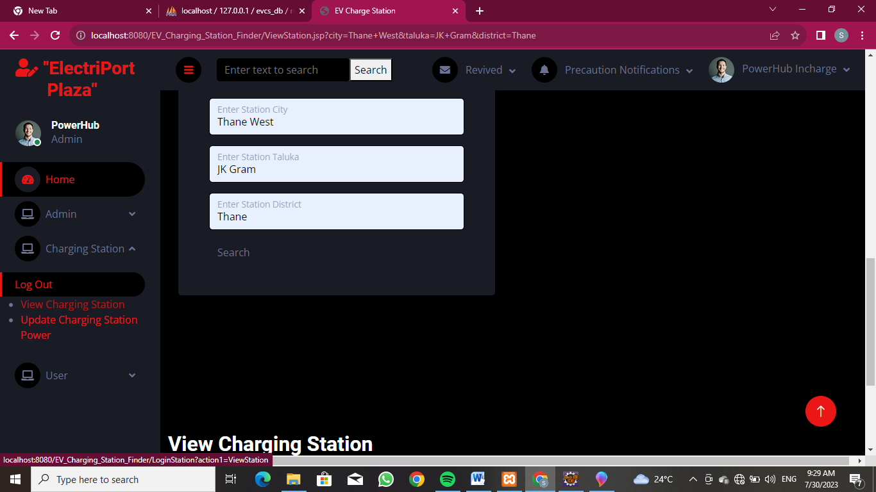
Charging Station Module SubMenu View Charging Station

Slide 21
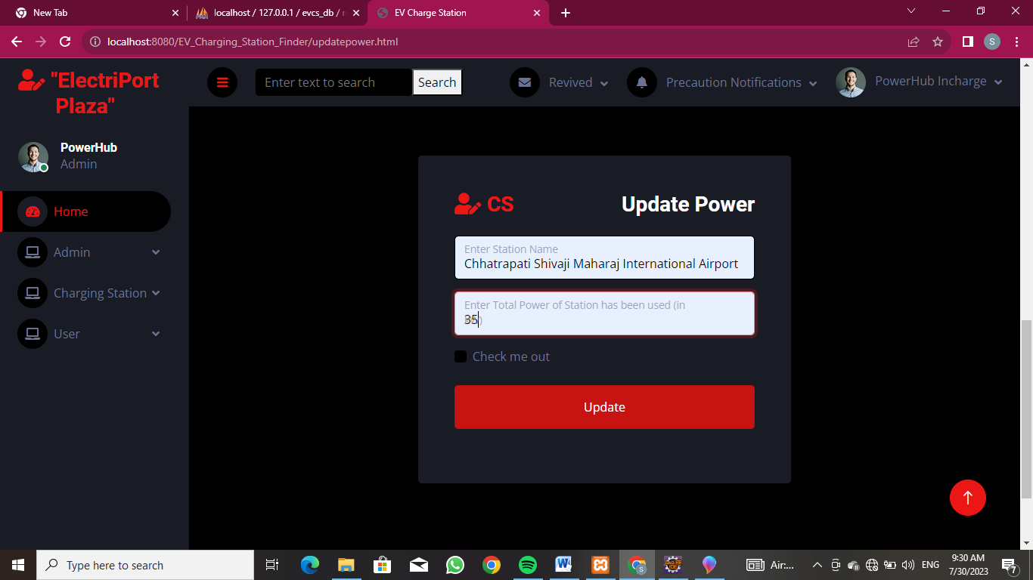
Charging Station Module SubMenu Update Charging Station Power

Slide 22
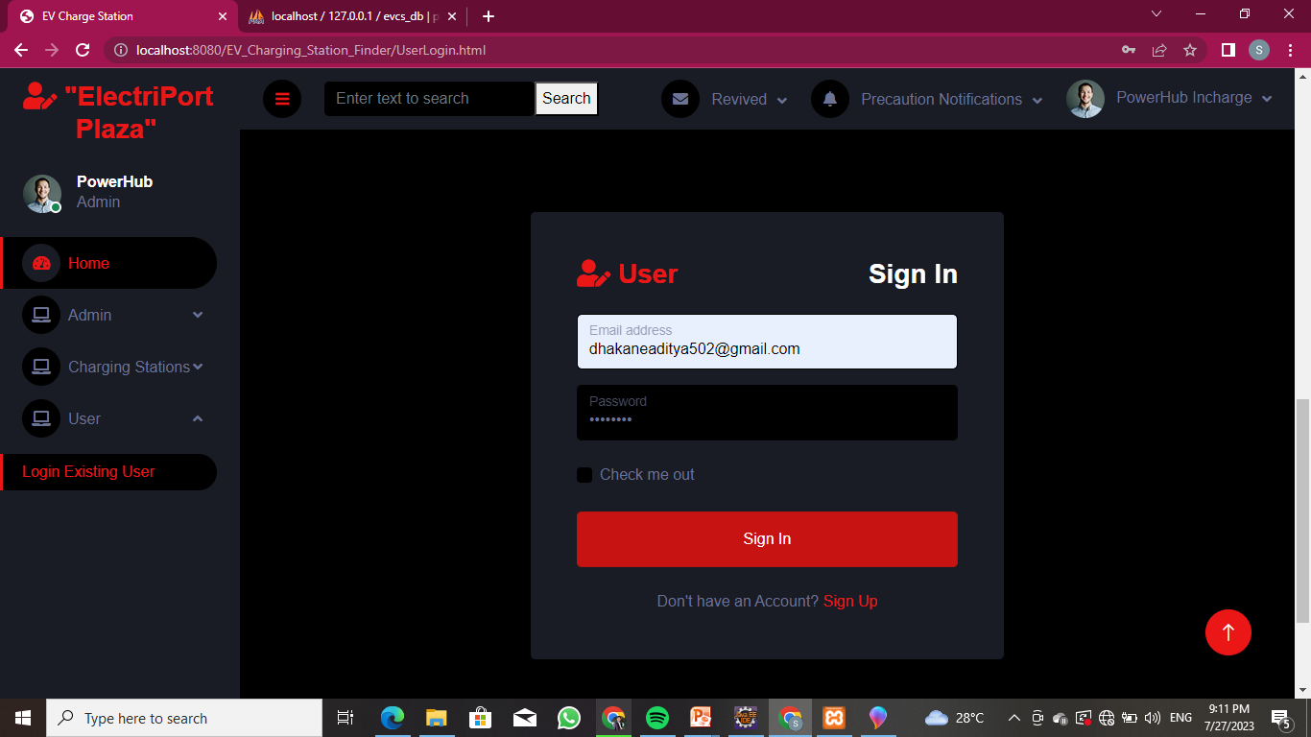
User Module

Slide 23
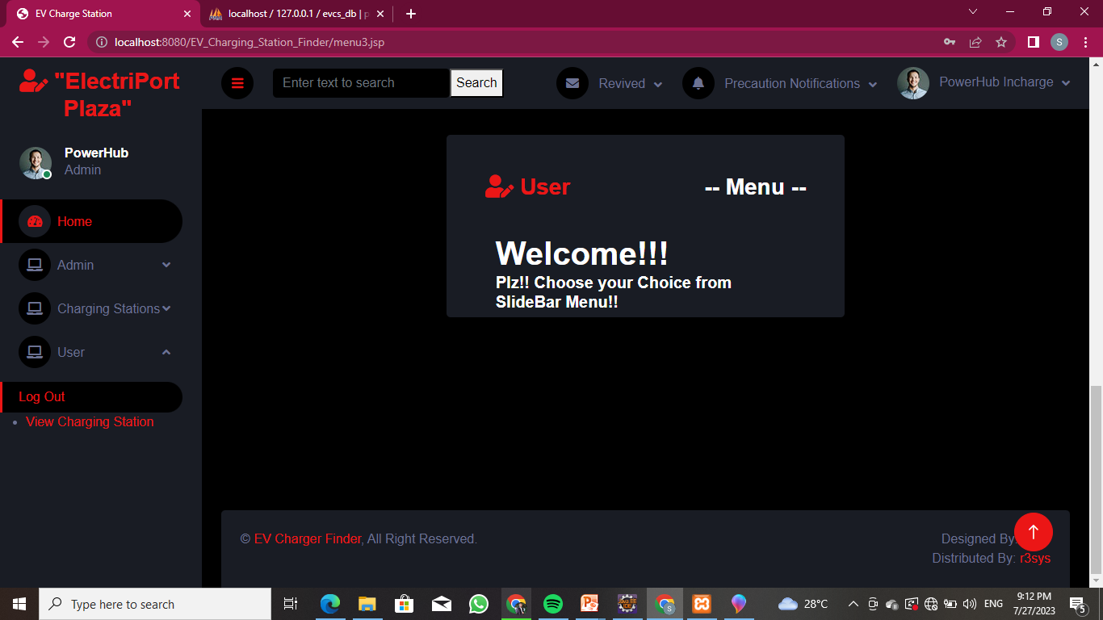
AfterUserLogin Shows User`s Menu

Slide 24
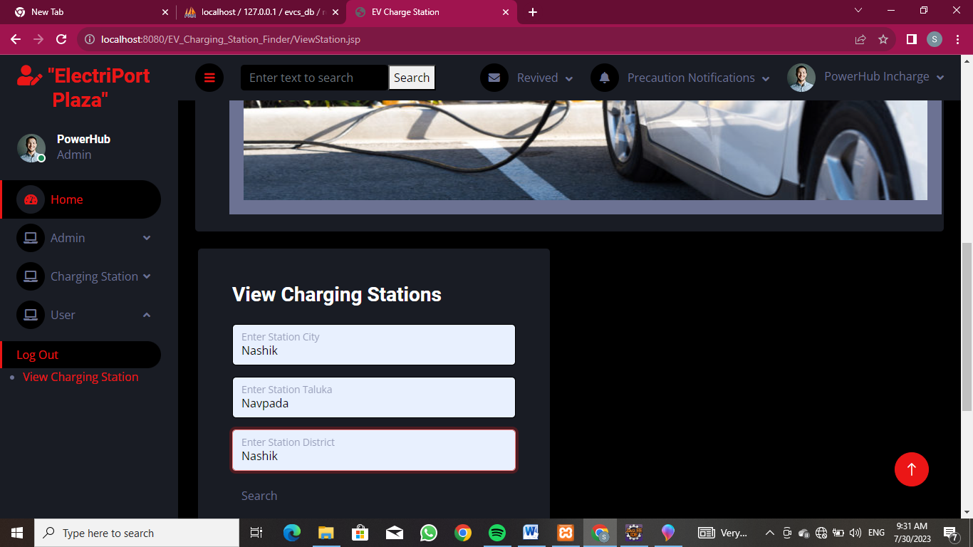
User Module SubMenu View Charging Station

Slide 25
Department of Computer Technology Industrial Training Summer 2023
Project Details implemented during Training
Title: Bank Management Services
Development Platform: Eclipse IDE, JDK 1.8, MySQL server
Output Generated: Developed Website
Snapshots :

Slide 26
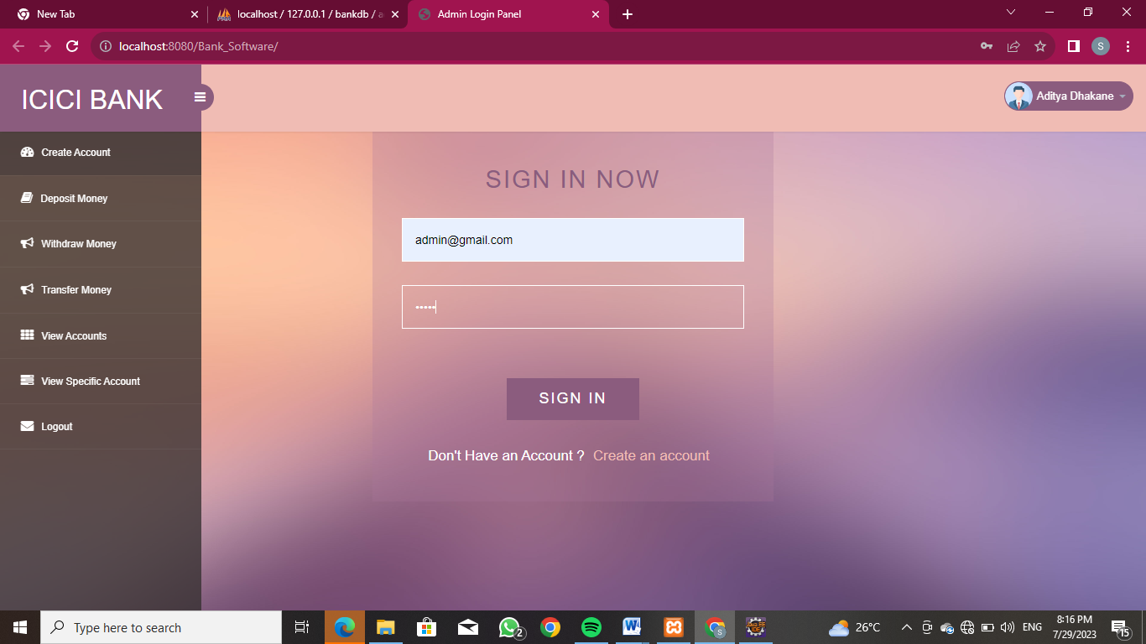
Home Page

Slide 27
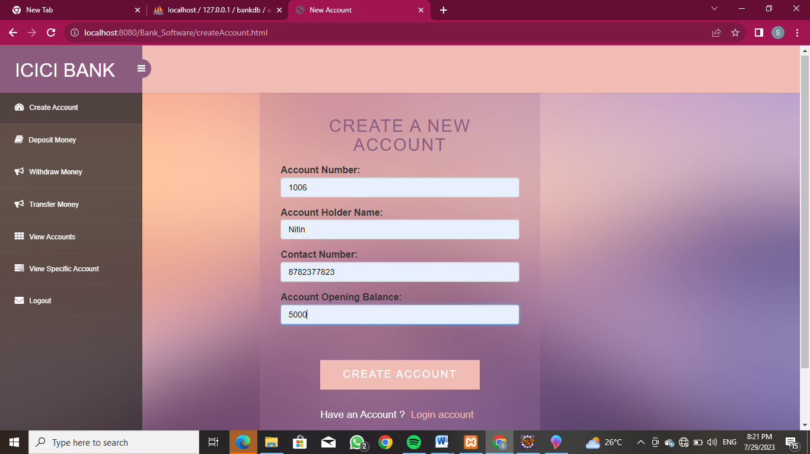
Create an Account Section

Slide 28
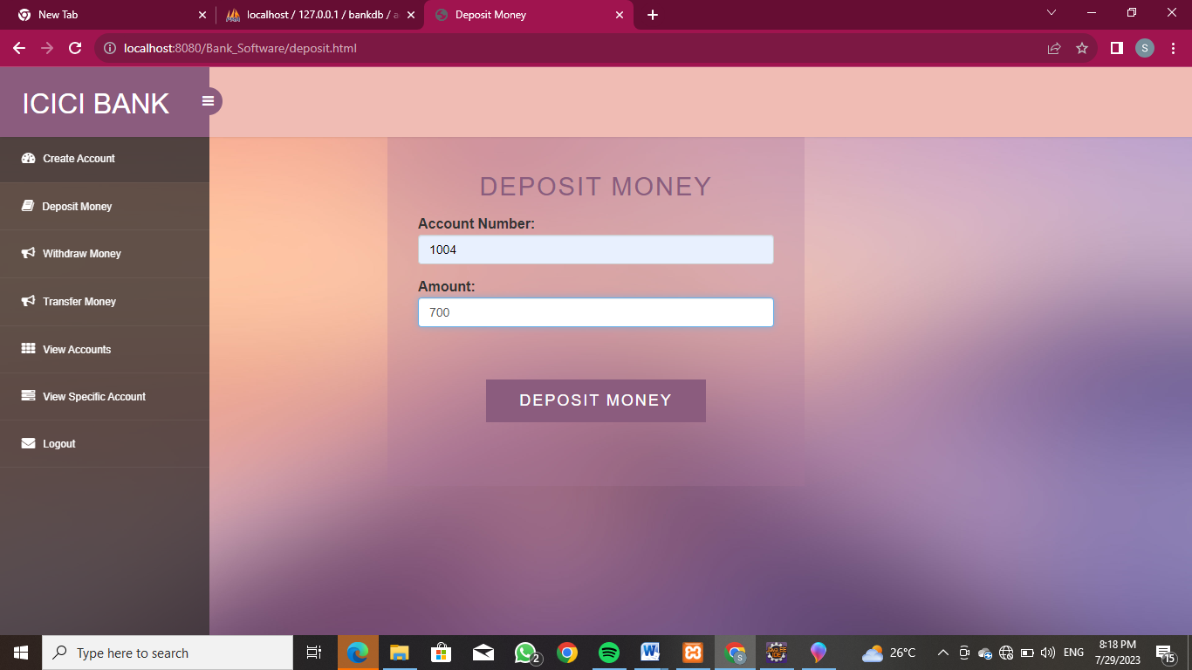
Deposit Money Section

Slide 29
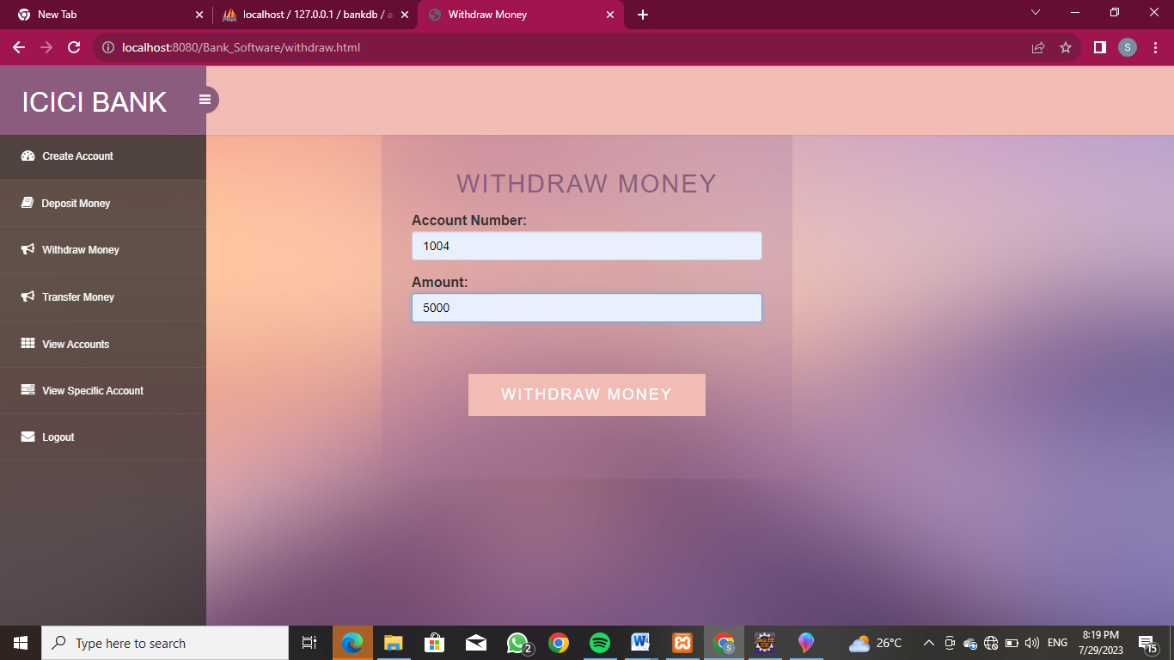
Withdraw Money Section

Slide 30
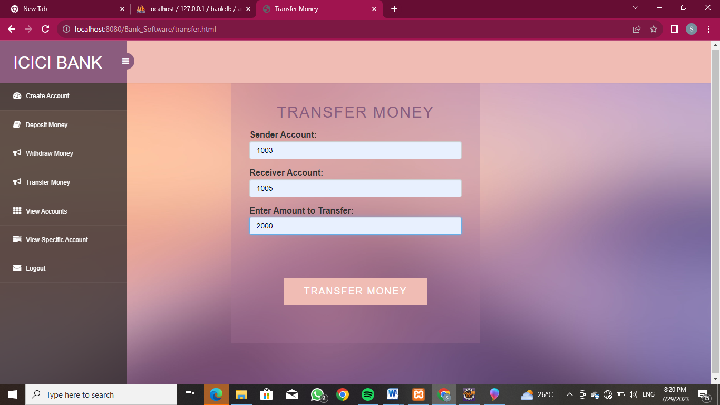
Transfer Money Section

Slide 31
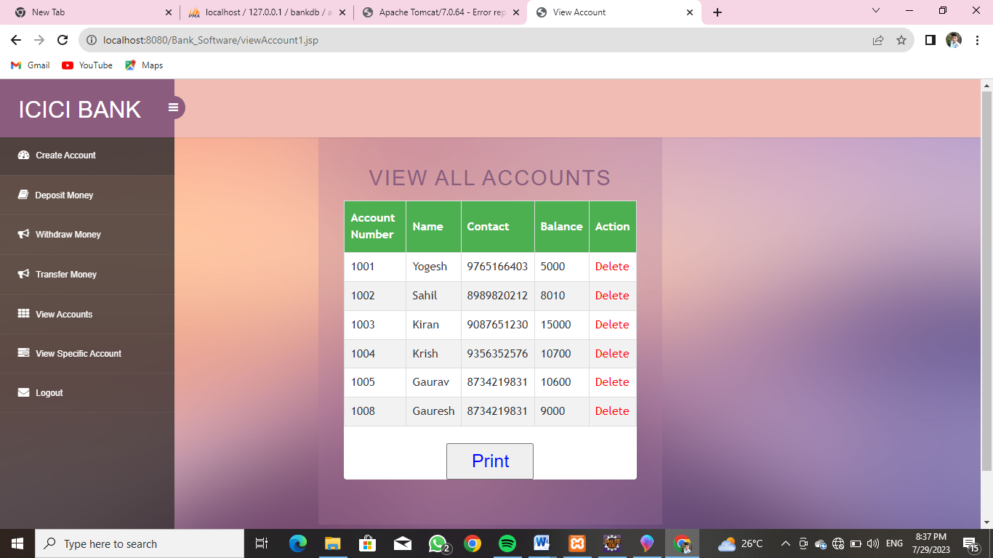
View Accounts Section

Slide 32
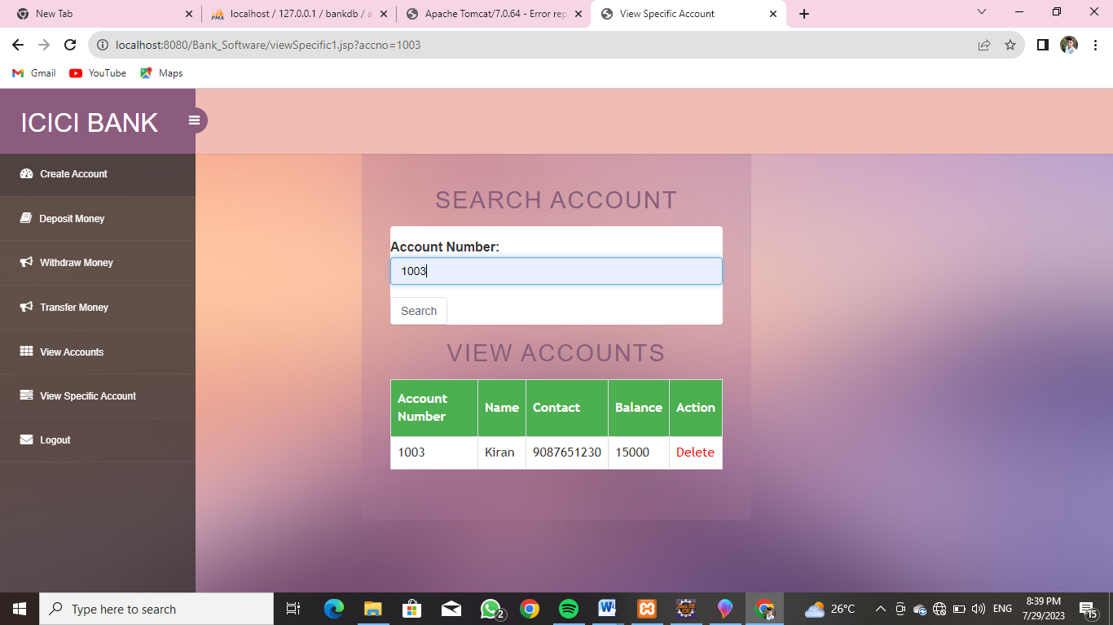
View Specific Accounts Section

Slide 33
Department of Computer Technology Industrial Training Summer 2023
References and Conclusion
List of web references taken:
https://www.w3school.com/
https://www.bootstrap.com/
https://www.r3sys.com/
https://chargefinder.com/en
https://nexonev.tatamotors.com/charging-locator/
End Result:
Learned different Languges and software’s which are
used by company to develop applications.
We learned how to make different websites.
Learned how to design project flow from client requirements.
We studied entire process of software development and its uses.

Slide 34
Department of Computer Technology Industrial Training Summer 2023
References and Conclusion
Outcome of Training:
We went through different products developed by the company and understood different features of that products.
We learned the concept of making Application and web hosting.
We saw live demonstration of Server Configuration.
We studied all services provided by R3System.

Slide 35
Department of Computer Technology Industrial Training Summer 2023
Thank You

